Slide 1

Analyzes the number of employees in each department, helping to understand workforce distribution and department size dynamics.
Employee Management System
M. Prasanna Kumar A. Gopichand D. Guru Sai Vishnu Tej
Project coordinator
SK. Shaheer
Trainer Innomatics
DD/MM/YYYY
Feature Name/Product
Your Company Name

Slide 2

Introduction
This presentation provides a comprehensive overview of the Employee management system SQL project. It highlights some key queries with detailed explanations to help understand data handling within the system. The focus is on insights into employee data, payroll, salary, bonus, department analysis, roles, and leave management.
DD/MM/YYYY
Feature Name/Product
Your Company Name

Slide 3
01
Objective of the Project:

Slide 4
EmployeeManagementSystem A comprehensive database solution to manage employee details, job roles, salaries, qualifications, leave, and payroll. The system ensures data integrity with relational structures and foreign keys, enabling efficient HR operations, streamlined payroll, and accurate employee information management across all departments.
DD/MM/YYYY
Feature Name/Product
Your Company Name

Slide 5
02
ER Diagram and schema explanation:

Slide 6
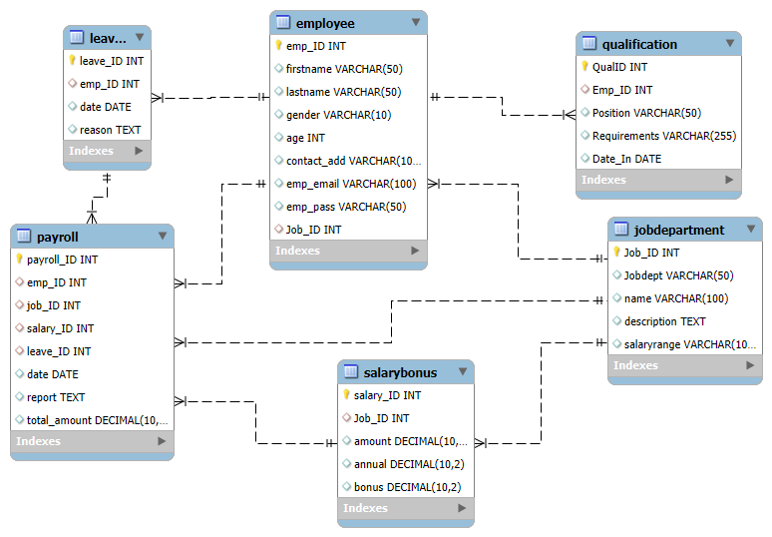
Entities & Attributes
Employee
emp_ID (PK)
name, gender, age
contact, email, password
Qualification
qual_ID (PK)
emp_ID (FK)
qualification details, requirements, hire_date
JobDepartment
dept_ID (PK)
emp_ID (FK)
department_name, job_description, salary_range
Payroll
payroll_ID (PK)
emp_ID (FK)
salary_ID, leave_days, date, report, total_amount
SalaryBonus
bonus_ID (PK)
emp_ID (FK)
base_amount, annual_salary, bonus_structure
Relationships
Employee → Qualification : One-to-Many (one employee can have multiple qualifications).
Employee → JobDepartment : One-to-One/Many (each employee belongs to a department).
Employee → Payroll : One-to-Many (employee can have multiple payroll records).
Employee → SalaryBonus : One-to-Many (employee can have multiple bonus/compensation records).
DD/MM/YYYY
Feature Name/Product
Your Company Name

Slide 7
03
Key analysis questions (use cases)

Slide 8
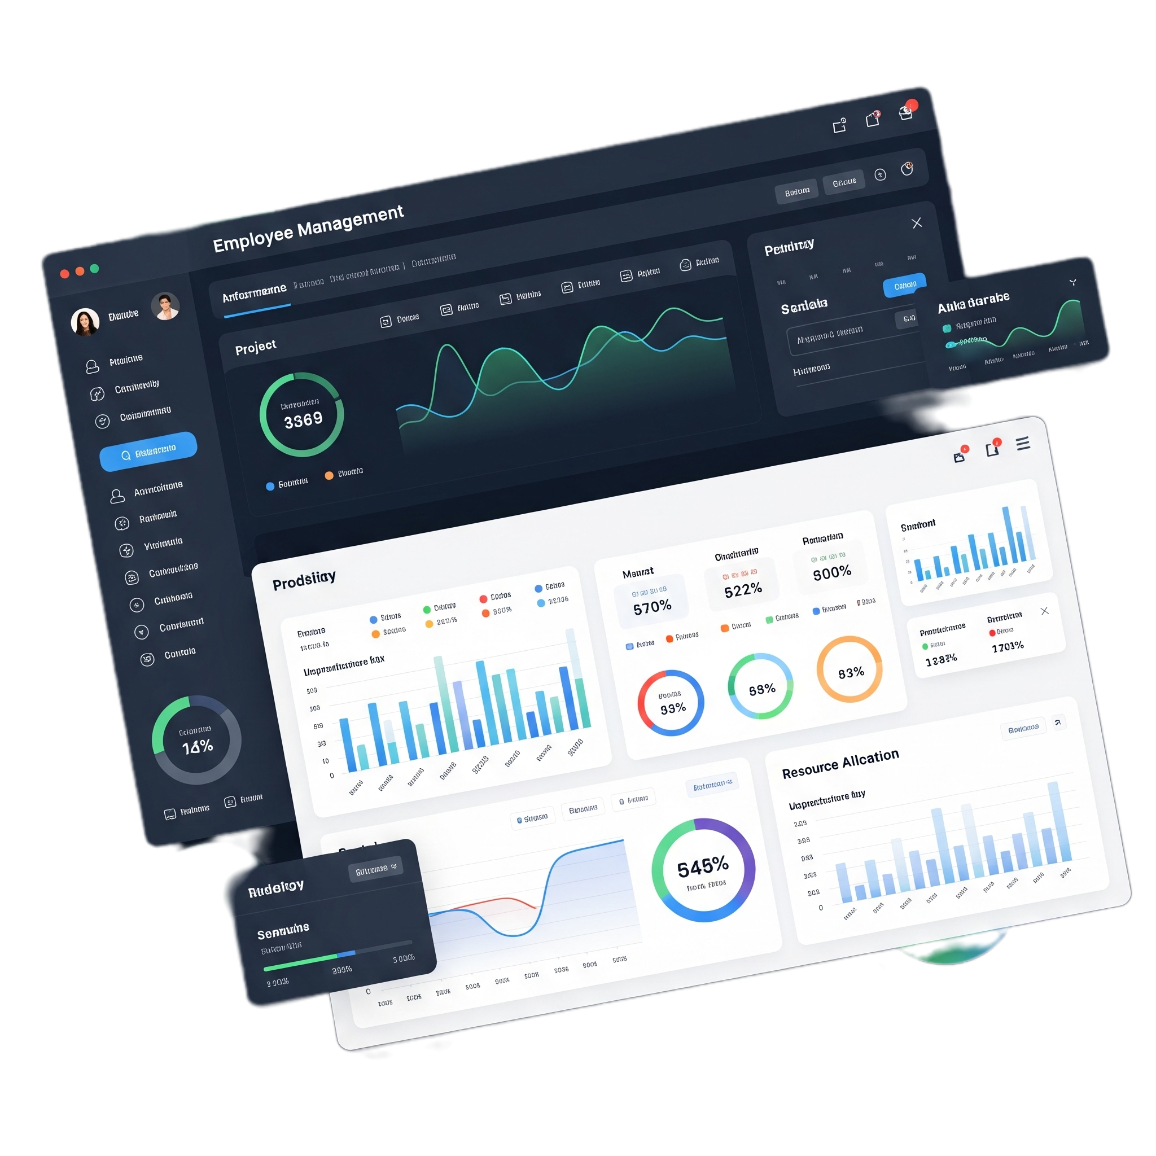
Analysis Questions
1. EMPLOYEE INSIGHTS
How many unique employees are currently in the system?
Which departments have the highest number of employees?
What is the average salary per department?
Who are the top 5 highest-paid employees?
What is the total salary expenditure across the company?
2. JOB ROLE AND DEPARTMENT ANALYSIS
How many different job roles exist in each department?
What is the average salary range per department?
Which job roles offer the highest salary?
Which departments have the highest total salary allocation?
DD/MM/YYYY
Feature Name/Product
Your Company Name

Slide 9
3. QUALIFICATION AND SKILLS ANALYSIS
How many employees have at least one qualification listed?
Which positions require the most qualifications?
4. LEAVE AND ABSENCE PATTERNS
Which year had the most employees taking leaves?
What is the average number of leave days taken by its employees per department?
Which employees have taken the most leaves?
5. PAYROLL AND COMPENSATION ANALYSIS
What is the total monthly payroll processed?
What is the average bonus given per department?
6. EMPLOYEE PERFORMANCE AND GROWTH
Which year had the highest number of employee promotions?
DD/MM/YYYY
Feature Name/Product
Your Company Name

Slide 10

3.1
EMPLOYEE INSIGHTS

Slide 11
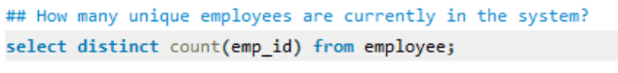
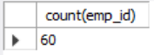
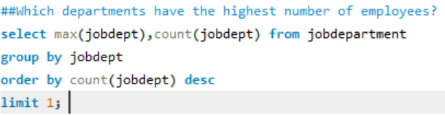
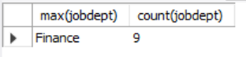
DD/MM/YYYY
Feature Name/Product
Your Company Name

Slide 12
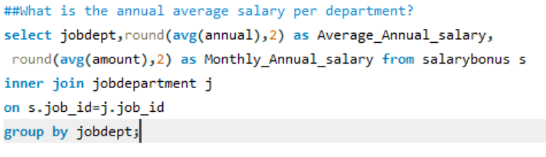
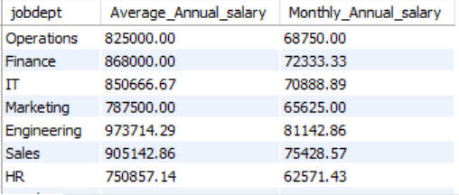

Slide 13
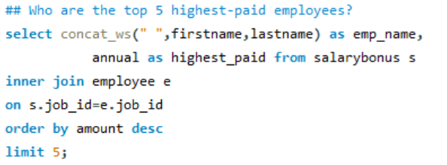
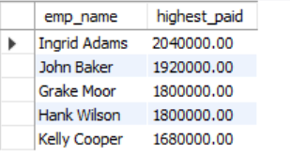

Slide 14
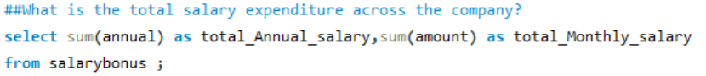
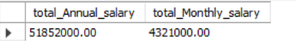

Slide 15

3.2
Job Roles and Department Analysis

Slide 16
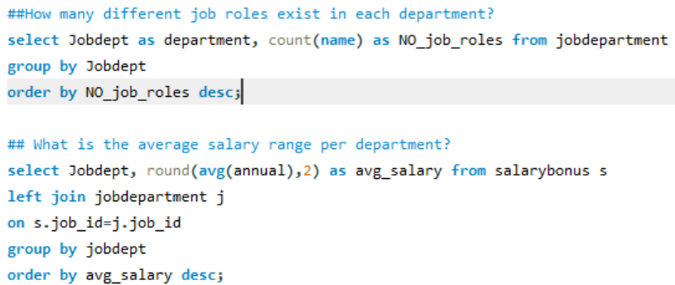
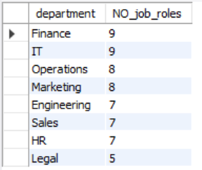
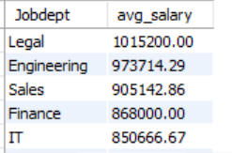

Slide 17
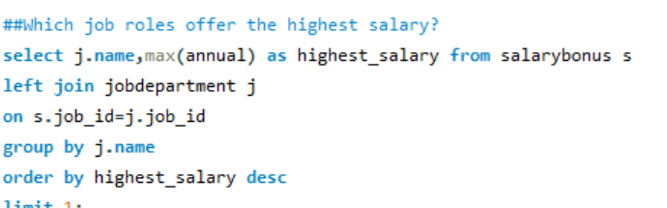
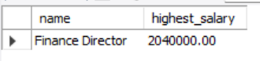

Slide 18
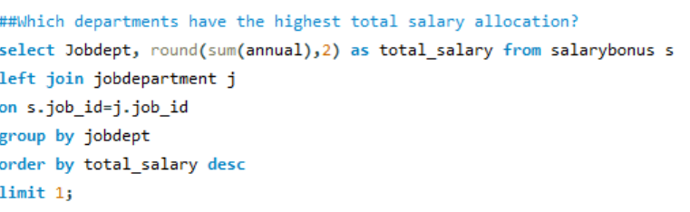
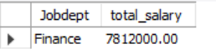

Slide 19

Departmental salary expenditures
Analyzes the total spending on salaries per department, helping optimize budgeting and financial planning.
DD/MM/YYYY
Feature Name/Product
Your Company Name

Slide 20
3.3
Qualification and Skills Insights

Slide 21
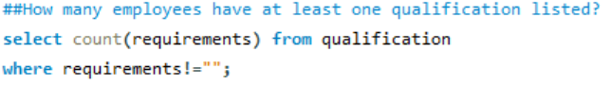
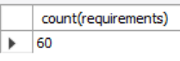
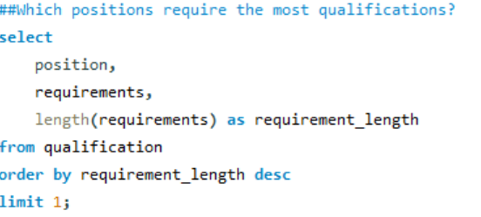
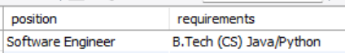

Slide 22
3.4
Leave and Absence Patterns

Slide 23
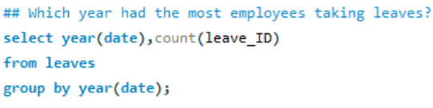
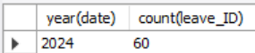
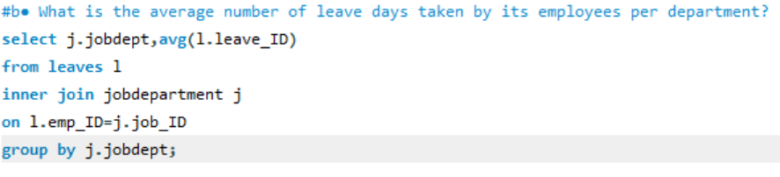
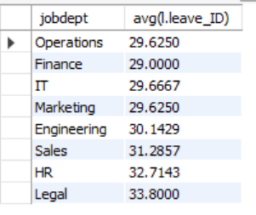

Slide 24
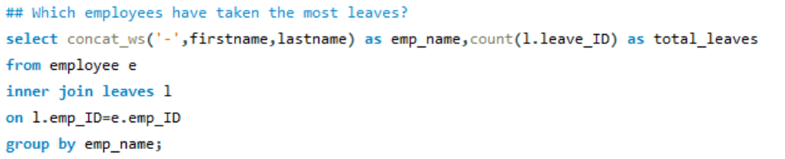
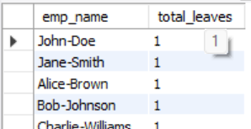

Slide 25
3.5
Payroll and Compensation Details

Slide 26
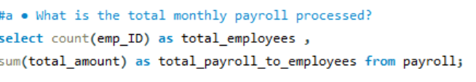
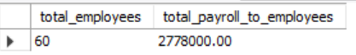
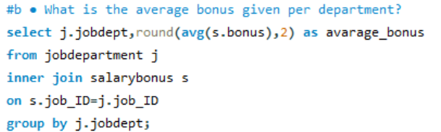
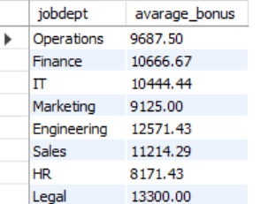

Slide 27
3.6
Employee Performance and Growth

Slide 28
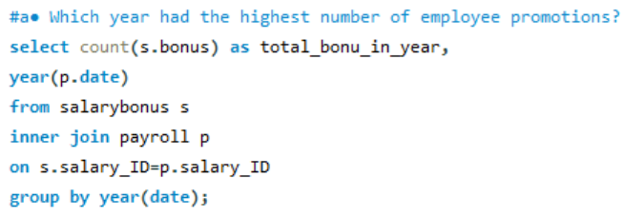
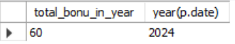

Slide 29

Conclusion:
This presentation covered key SQL queries used to analyze employee data, payroll, qualifications, leave, and performance within an employee management system.
These insights provide a solid foundation for data-driven HR decisions, financial oversight, and organizational development strategies aimed at optimizing workforce management.
DD/MM/YYYY
Feature Name/Product
Your Company Name

Slide 30

Challenges
Defining correct table relationships and ensuring accurate use of foreign keys.
Maintaining data consistency with cascading updates and deletes.
Writing complex joins for reports involving employee roles, leaves, and payroll.
Ensuring all date fields follow the YYYY-MM-DD format for reliable time-based analysis.
Preventing duplicate entries using unique constraints, especially on email fields.
DD/MM/YYYY
Feature Name/Product
Your Company Name

Slide 31

THANK YOU
Any Questions ?

